Slide 1
WHAT IS DATA SCIENCE?
“Data science, also known as data-driven science, is an interdisciplinary field of scientific methods, processes, algorithms and systems to extract knowledge or insights from data in various forms, either structured or unstructured, similar to data mining.”
What is the difference between data and Knowledge?
What is the difference between data science and data mining?

Slide 2
WHAT IS DATA SCIENCE?
“Data science intends to analyze and understand actual phenomena with ‘data’. In other words, the aim of data science is to reveal the features or the hidden structure of complicated natural, human, and social phenomena with data from a different point of view from the established or traditional theory and method.”
Fourth paradigm
“… change of all sciences moving from observational, to theoretical, to computational and now to the 4th Paradigm – Data-Intensive Scientific Discovery”

Slide 3
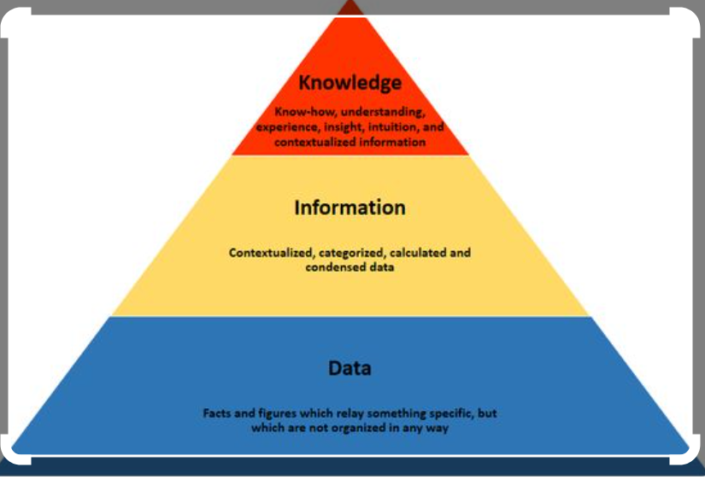
Data / Information / Knowledge

Slide 4
WHAT IS IMPORTANT?
Need to solve a real problem using data… No applications, no data science.

Slide 5

DATA SCIENCE AS A UNIFIER
Humanities
Machine/Statistical Learning
Data Management
Application Domain Expertise
Data Science
Law
Social Science
Visualization
Mathematical Optimization

Slide 6
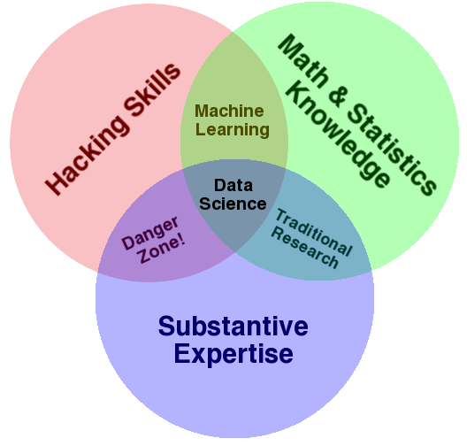
Drew Conway Venn Diagram

Slide 7
For better or worse, data is a commodity traded electronically; therefore, in order to be in this market you need to speak hacker.. Being able to manipulate text files at the command-line, understanding vectorized operations, thinking algorithmically; these are the hacking skills that make for a successful data hacker.

Slide 8
Once you have acquired and cleaned the data, the next step is to actually extract insight from it. In order to do this, appropriate math and statistics methods are applied, which requires at least a baseline familiarity with these tools.

Slide 9
In the third critical piece—substance—, data plus math and statistics only gets us machine learning, which is great if that is what you are interested in, but not if you are doing data science. Science is about discovery and building knowledge, which requires some motivating questions about the world and hypotheses that can be brought to data and tested with statistical methods.

Slide 10
Finally, a word on the hacking skills plus substantive expertise danger zone. People who, "know enough to be dangerous," and is the most problematic area of the diagram.

Slide 11
DATA SCIENCE AND BIG DATA
They are not the “same thing”
Big data = crude oil
Big data is about extracting “crude oil”, transporting it in “mega tankers”, siphoning it through “pipelines”, and storing it in “massive silos”
Data science is about refining the “crude oil”
Carlos Samohano, Founder, Data Science London

Slide 12
DATA SCIENCE MACHIENE LEARNING
It deals with understanding and finding hidden patterns or useful insights from the data, which helps to take smarter business decisions. | It is a subfield of data science that enables the machine to learn from the past data and experiences automatically.
It is used for discovering insights from the data. It is used for making predictions and classifying the result for new data points. It is a broad term that includes various steps to create a model for a given problem and deploy the model. | It is used in the data modeling step of the data science as a complete process.
A data scientist needs to have skills to use big data tools like Hadoop, Hive and Pig, statistics, programming in Python, R, or Scala. | Machine Learning Engineer needs to have skills such as computer science fundamentals, programming skills in Python or R, statistics and probability concepts, etc.

Slide 13
Contd..
It can work with raw, structured, and unstructured data. | It mostly requires structured data to work on.
Data scientists spent lots of time in handling the data, cleansing the data, and understanding its patterns. | ML engineers spend a lot of time for managing the complexities that occur during the implementation of algorithms and mathematical concepts behind that.

Slide 14
EVOLUTION OF DATA SCIENCE
Data science was born from the idea of merging applied statistics with computer science.
Scientists realized they could not only collect data and solve statistical problems but also use that data to solve real-world problems and make reliable fact-driven predictions.

Slide 15
1962: American mathematician John W. Tukey first articulated the data science In his famous article “The Future of Data Analysis,”.
Another early figure was Peter Naur, a Danish computer engineer whose book Concise Survey of Computer Methods offers one of the very first definitions of data science
“The science of dealing with data, once they have been established, while the relation of the data to what they represent is delegated to other fields and sciences.”

Slide 16
1977: The International Association for Statistical Computing (IASC) was established, whose mission was “to link traditional statistical methodology, modern computer technology, and the knowledge of domain experts in order to convert data into information and knowledge.”

Slide 17
1980s and 1990s: Data science began taking more significant strides with the emergence of the first Knowledge Discovery in Databases (KDD) workshop and the founding of the International Federation of Classification Societies (IFCS). These two societies were among the first to focus on educating and training professionals in the theory and methodology of data science.

Slide 18
1994: Business Week published a story on the new phenomenon of “Database Marketing.” It described the process by which businesses were collecting and leveraging enormous amounts of data to learn more about their customers, competition, or advertising techniques. The only problem at the time was that these companies were flooded with more information than they could possibly manage.

Slide 19
1990s and early 2000s: Several data science academic journals began to circulate, and data science proponents like Jeff Wu and William S. Cleveland continued to help develop and expound upon the necessity and potential of data science.
2000s: Technology made enormous leaps by providing nearly universal access to internet connectivity, communication, and (of course) data collection.

Slide 20
2005: Big data enters the scene. With tech giants such as Google and Facebook uncovering large amounts of data, new technologies capable of processing them became necessary. Hadoop rose to the challenge, and later on Spark and Cassandra made their debuts.
2014: Due to the increasing importance of data, and organizations’ interest in finding patterns and making better business decisions, demand for data scientists began to see dramatic growth in different parts of the world.

Slide 21
2015: Machine learning, deep learning, and Artificial Intelligence (AI) officially enter the realm of data science. These technologies have driven innovations over the past decade — from personalized shopping and entertainment to self-driven vehicles along with all the insights to efficiently bring forth these real-life applications of AI into our daily lives
2018: New regulations in the field are perhaps one of the biggest aspects in the evolution in data science.

Slide 22
2020s: Additional breakthroughs in AI, machine learning, and an ever-more-increasing demand for qualified professionals.
The Future of Data Science
Data scientists are working tirelessly toward developments in deep learning to make computers smarter. These developments can bring about advanced robotics paired with a powerful AI. Experts predict the AI will be capable of understanding and interacting seamlessly with humans, self-driving vehicles, and automated public transportation in a world interconnected like never before. This new world will be made possible by data science.

Slide 23
DATA SCIENCE ROLES
Data Analyst
Data Analysts are tapped to work with a variety of departments and individuals, so collaboration and communication skills are a must, especially when explaining technical ideas to non-technical teams.
Responsibilities: Accessing and cleaning data, performing statistical analysis, visualizing and communicating the results
Programming languages required: Python, R, SQL
Tools/skills required: Data science programming, probability and statistics, collaboration, communication
Growth potential: Many Data Analysts go on to become senior analysts or take on a management role at larger companies with data teams
Top industries: Finance, insurance, gambling, retail banking, consumer products, healthcare, energy

Slide 24
Data Scientist
Data Scientists have a solid understanding of handling raw data, analyzing it and sharing insights in a compelling way. Since the role tends to be more independent, motivation and curiosity go a long way for these professionals.
Responsibilities: Analyzing data, building and training machine learning models to make reliable future predictions
Programming languages required: Python, R
Tools/skills required: Everything required from a data analyst, plus strong foundations in math, analytics and computer science, knowledge of machine learning methods, statistical models, advanced data science programming and familiarity with Apache Spark
Growth potential: Data Scientists may move on to become a senior data scientist, while some decide to take the path to become a machine learning engineer or a chief data officer
Top industries: Healthcare, telecommunications, energy, automotive

Slide 25
Business Analyst
The main goal for individuals in this role is to facilitate potential solutions to organizational problems, but they should also be prepared to take on additional responsibilities like quality assurance and management. Needless to say, time management and prioritization are common traits shared among successful Business Analysts.
Responsibilities: Use data-driven insights to clearly communicate initiatives throughout entire organizations, often acting as the intermediary between a company’s business and tech teams
Programming languages required: SQL, Tableau
Tools/skills required: Understanding of business processes, data visualization tools, listening and storytelling, data modeling
Growth potential: With experience, many Business Analysts take on a leadership title or move on to more senior roles in product management
Top industries: Telecom, utilities, real estate, healthcare, government, pharmaceuticals

Slide 26
Software Engineer
Software Engineer might be tasked with optimizing certain product features based on user data, or they might be responsible for building a new program that will ultimately increase a company’s bottom line.
Responsibilities: Collaborate with data scientists and business analysts to ensure alignment between the business objectives and the analytics back-end of the software they are working to produce or modify, as well as ensure the scalability and security of the final product
Programming languages required: Java, Python, C, C++
Tools/skills required: Experience with machine learning and deep learning frameworks, understanding of mathematics including linear algebra and statistics, strong programming and debugging skills, data processing, writing and communication and attention to detail
Growth potential: Given the fact that this is a relatively new role within the industry, the opportunities for individuals holding this role are virtually endless
Top industries: Retail, healthcare, research and development, government and defense, IT services

Slide 27
Marketing Data Scientist
When a company builds a new campaign, it’s up to the Marketing Data Scientist to analyze company data and user research to inform the marketing strategy around the launch and measure its outcomes. On a granular level, this could involve anything from email marketing and search engine optimization (SEO) to web analytics and growth hacking
Responsibilities: Gather and analyze data to objectively strategize the launch and evolution of a business’s promotions and marketing campaigns while communicating between stakeholders
Programming languages required: SQL, Python, R, Tableau
Tools/skills required: Solid understanding of data analytics, objective thinking, strong communication and adaptability
Growth potential: With so many specialties to choose from, the sky’s the limit for individuals holding a Marketing Data Scientist role, some of whom go on to hold senior-level positions or even start their own companies
Top industries: Banking and finance, advertising, retail, technology, travel

Slide 28
Machine Learning Engineer
While Data Scientists build a company’s machine learning models and Data Analysts determine which data is worthy of exploring, it’s the Machine Learning Engineer who wrangles and applies the algorithms to the datasets. There’s plenty of trial-and-error involved in the job, so persistence and resilience are key contributors to success
Responsibilities: Processing data provided by a company’s Data Analyst using machine learning algorithms developed by the Data Scientist to glean insights that will ultimately drive business decisions
Programming languages required: R, Java, Python, C++
Tools/skills required: Strong communication paired with an understanding of data structures, vectors, matrices, derivatives and integrals, as well as statistical concepts and probability theory
Growth potential: Many Machine Learning Engineers progress to become more specialized in deep learning methods, while others transition to machine learning researchers or leads on data engineering teams
Top industries: Healthcare, financial services, retail, government, transportation

Slide 29

DATA SCIENCE APPLICATION EXAMPLES
Fraud detection
Investigate fraud patterns in past data
Early detection is important
Before damage propagates
Harder than late detection
Precision is important
False positive and false negative are both bad
Real-time analytics
11

Slide 30
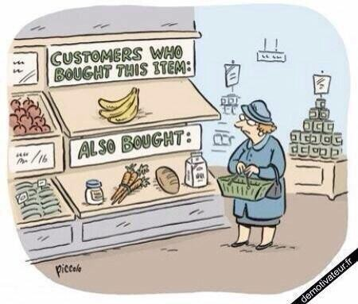
DATA SCIENCE APPLICATION EXAMPLES
Recommender systems
The ability to offer unique personalized service
Increase sales, click-through rates, conversions, …
Netflix recommender system valued at
$1B per year
Amazon recommender system drives a 20-35% lift in sales annually
Collaborative filtering at scale
12

Slide 31

DATA SCIENCE APPLICATION EXAMPLES
Predicting why patients are being readmitted
Reduce costs
Improve population health
Find the “why” behind specific populations being readmitted
Data lakes of multiple data sources
d
13

Slide 32
What Is the Data Science Process?
The data science process is a systematic approach to solve a data problem. It provides a structured framework for articulating a problem as a question, deciding how to solve it, and then presenting the solution to stakeholders.

Slide 33
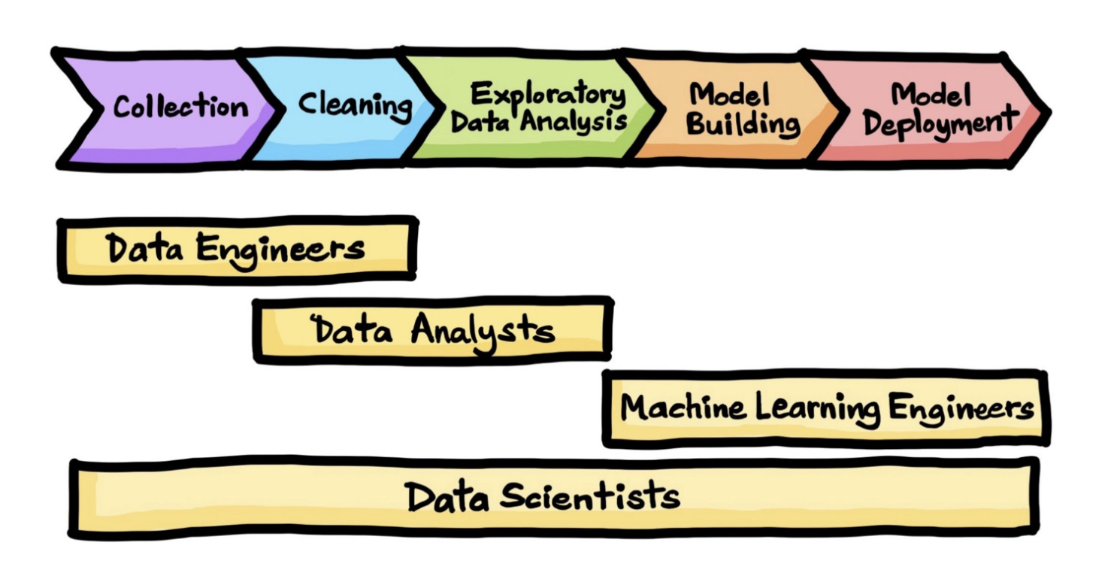

Slide 34
Framing the Problem
Understanding and framing the problem is the first step of the data science life cycle. This framing will help you build an effective model that will have a positive impact on your organization.
Collecting Data
The next step is to collect the right set of data. High-quality, targeted data—and the mechanisms to collect them—are crucial to obtaining meaningful results. Since much of the roughly 2.5 quintillion bytes of data created every day come in unstructured formats, you’ll likely need to extract the data and export it into a usable format, such as a CSV or JSON file.

Slide 35
Cleaning Data
Most of the data you collect during the collection phase will be unstructured, irrelevant, and unfiltered. Bad data produces bad results, so the accuracy and efficacy of your analysis will depend heavily on the quality of your data.
Cleaning data eliminates duplicate and null values, corrupt data, inconsistent data types, invalid entries, missing data, and improper formatting.
This step is the most time-intensive process, but finding and resolving flaws in your data is essential to building effective models.

Slide 36
Exploratory Data Analysis (EDA)
Now that you have a large amount of organized, high-quality data, you can begin conducting an exploratory data analysis (EDA). Effective EDA lets you uncover valuable insights that will be useful in the next phase of the data science lifecycle.
Observe your dataset. ...
Find any missing values. ...
Categorize your values. ...
Find the shape of your dataset. ...
Identify relationships in your dataset. ...
Locate any outliers in your dataset.

Slide 37
Model Building and Deployment
Next, you’ll do the actual data modeling. This is where you’ll use machine learning, statistical models, and algorithms to extract high-value insights.
Communicating Your Results
Lastly, you’ll communicate your findings to stakeholders. Every data scientist needs to build their repertoire of visualization skills to do this.
Your stakeholders are mainly interested in what your results mean for their organization, and often won’t care about the complex back-end work that was used to build your model. Communicate your findings in a clear, engaging way that highlights their value in strategic business planning and operation.

Slide 38
Data Security Issues
Data Storage
Businesses are adopting Cloud Data Storage to move their data easily to expedite business operations. However, the risks involved are exponential with security issues. Even the slightest mistake in controlling the access of data can allow anyone to get a host of sensitive data.
While mission-critical information can be stored in on-premise databases, less sensitive data is kept in the cloud for ease of use.

Slide 39
Fake Data
Fake Data generation poses a severe threat to businesses as it consumes time that otherwise could be spent to identify or solve other pressing issues. There is more scope for leveraging inaccurate information on a very large scale, as assessing individual data points can be a daunting task for companies.
An ideal approach is to validate the data sources by periodic assessments and evaluate Machine Learning models with diverse test datasets to find anomalies.

Slide 40
Data Privacy
It aims to safeguard personal or sensitive information from cyber attacks, breaches, and intentional or unintentional data loss.
Businesses must follow stricter Data Privacy principles with the help of access management services in the cloud, including very rigid privacy compliance, to strengthen Data Protection.
The general rules are knowing your data, having more grip over your data stores and backup, safeguarding your network against unauthorized access, conducting regular risk assessments, and training the users regularly about Data Privacy and Data Security

Slide 41
Data Management
A security breach can have crushing consequences on businesses, including the vulnerability of critical business information to a completely compromised database.
Deploying highly secured databases is vital to ensure data security at all levels. A superior Database Management System comes with various access controls.
A few methods to effectively SAGEGUARDING DATA STORAGE are—practicing data encryption, data segmenting and partitioning, securing on-the-move, and implementing a trusted server

Slide 42
Data Access Control
Controlling which data users can view or edit enables companies to ensure not only data integrity but also preserves its privacy
Identity Access Management does the job of controlling data flow via identification, authentication, and authorization

Slide 43
Data Poisoning
There are several Machine Learning solutions like chatbots that are trained on a colossal amount of data. The advantages of such solutions are that they keep on improving as users interact. However, this leads to Data Poisoning, a technique to attack Machine Learning models’ training data.
The best way to beat the evasion is through outlier detection, wherein the injected elements in the training pool can get separated from the existing data distribution.

Slide 44
Employee Theft
Advance data culture has allowed every employee to hold a certain level of critical business information.
To avoid Employee Theft, companies have to implement legal policies along with securing the network with a virtual private network. In addition, companies can use a Desktop as a Service (DaaS) to eliminate the functionalities of data stored in local drives.

Slide 45
What is Data Collection
Data collection is the process of collecting, measuring and analyzing different types of information using a set of standard validated techniques.
The main objective of data collection is to gather information-rich and reliable data, and analyze them to make critical business decisions.
Once the data is collected, it goes through a rigorous process of data cleaning and data processing to make this data truly useful for businesses.

Slide 46
There are two main methods of data collection in research
Primary Data Collection
Secondary Data Collection

Slide 47
Primary data refers to data collected from first-hand experience directly from the main source.
The methods of collecting primary data can be further divided into quantitative data collection methods (deals with factors that can be counted) and qualitative data collection methods (deals with factors that are not necessarily numerical in nature).

Slide 48
Interview : It is simply a process in which the interviewer asks questions and the interviewee responds to them.
It provides a high degree of flexibility because questions can be adjusted and changed anytime according to the situation
Observations :In this method, researchers observe a situation around them and record the findings
It can be used to evaluate the behaviour of different people in controlled (everyone knows they are being observed) and uncontrolled (no one knows they are being observed) situations.
For example, a person looks at random people that walk their pets on a busy street, and then uses this data to decide whether or not to open a pet food store in that area.

Slide 49
Surveys and Questionnaires
They can be conducted face-to-face, mailed, or even posted on the Internet to get respondents from anywhere in the world.
A drawback of surveys and questionnaires is delayed response and the possibility of ambiguous answers.
Focus Group
A focus group is similar to an interview, but it is conducted with a group of people who all have something in common.
Some drawbacks of this method are lack of privacy and domination of the interview by one or two participants

Slide 50
Secondary Data Collection Methods
Internet
There is a large pool of free and paid research resources that can be easily accessed on the Internet.
You should only source from authentic sites while collecting information.
Government Archives
The most important advantage is that the data in government archives are authentic and verifiable.
The challenge, however, is that data is not always readily available due to a number of factors.
For example, criminal records can come under classified information and are difficult for anyone to have access to them.

Slide 51
Libraries
You can collect important and authentic information based on different research contexts. Libraries also serve as a storehouse for business directories, annual reports and other similar documents that help businesses in their research.

Slide 52
Data preprocessing techniques
There are two main categories of preprocessing -- data cleansing and feature engineering.
Data cleansing
Techniques for cleaning up messy data include the following
Identify and sort out missing data. There are a variety of reasons a data set might be missing individual fields of data. Data scientists need to decide whether it is better to discard records with missing fields, ignore them or fill them in with a probable value.

Slide 53
Reduce noisy data. Real-world data is often noisy, which can distort an analytic or AI model.
For example, a temperature sensor that consistently reported a temperature of 75 degrees Fahrenheit might erroneously report a temperature as 250 degrees.
A variety of statistical approaches can be used to reduce the noise, including binning, regression and clustering.

Slide 54
Identify and remove duplicates. When two records seem to repeat, an algorithm needs to determine if the same measurement was recorded twice, or the records represent different events.
In some cases, there may be slight differences in a record because one field was recorded incorrectly.
In other cases, records that seem to be duplicates might indeed be different,
As in a father and son with the same name who are living in the same house but should be represented as separate individuals.

Slide 55
Feature engineering
Feature engineering, as noted, involves techniques used by data scientists to organize the data in ways that make it more efficient to train data models and run inferences against them. These techniques include the following:
Feature scaling or normalization. Often, multiple variables change over different scales, or one will change linearly while another will change exponentially. For example, salary might be measured in thousands of dollars, while age is represented in double digits. Scaling helps to transform the data in a way that makes it easier for algorithms to tease apart a meaningful relationship between variables.

Slide 56
Data reduction. Data scientists often need to combine a variety of data sources to create a new AI or analytics model.
Some of the variables may not be correlated with a given outcome and can be safely discarded.
Other variables might be relevant, but only in terms of relationship -- such as the ratio of debt to credit in the case of a model predicting the likelihood of a loan repayment; they may be combined into a single variable.
Techniques like principal component analysis play a key role in reducing the number of dimensions in the training data set into a more efficient representation.

Slide 57
Discretization. It's often useful to lump raw numbers into discrete intervals. For example, income might be broken into five ranges that are representative of people who typically apply for a given type of loan. This can reduce the overhead of training a model or running inferences against it.

Slide 58
Structured Data
Categorized as quantitative data
Highly organized
It has been organized into a formatted repository that is typically a database.
Easily decipherable by machine learning algorithms
Examples of structured data include dates, names, addresses, credit card numbers, etc.

Slide 59
Advantages of Structured Data
Easily used by machine learning (ML) algorithms.
Easily used by business users.
Accessible by more tools

Slide 60
Disadvantages of Structured Data
Limited usage: Data with a predefined structure can only be used for its intended purpose, which limits its flexibility and usability.
Limited storage options: Structured data is generally stored in data storage systems with rigid schemas (e.g., data Warehouse). Therefore, changes in data requirements necessitate an update of all structured data, which leads to a massive expenditure of time and resources.

Slide 61
Structured data tools
OLAP (online analytical processing): Performs high-speed, multidimensional data analysis from unified, centralized data stores.
SQLite: Implements a self-contained, serverless, zero-configuration, transactional relational database engine.
MYSQL: Embeds data into mass-deployed software, particularly mission-critical, heavy-load production system.
PostgreSQL: Supports SQL and JSON querying as well as high-tier programming languages (C/C+, Java, Python, etc.).

Slide 62
Use cases for structured data
Customer relationship management (CRM): CRM software runs structured data through analytical tools to create datasets that reveal customer behavior patterns and trends.
Online booking: Hotel and ticket reservation data (e.g., dates, prices, destinations, etc.) fits the “rows and columns” format indicative of the pre-defined data model.
Accounting: Accounting firms or departments use structured data to process and record financial transactions.

Slide 63
Unstructured Data
Categorized as qualitative data.
Data which is not organized in a predefined manner
Cannot be processed and analyzed via conventional data tools and methods
It is best managed in non-relational(NoSQL) database.
Examples of unstructured data include text, mobile activity, social media posts, Internet of Things (IoT) sensor data.

Slide 64
Advantages of Structured Data
Native format: Unstructured data, stored in its native format, remains undefined until needed. Its adaptability increases file formats in the database, which widens the data pool and enables data scientists to prepare and analyze only the data they need.
Fast accumulation rates: Since there is no need to predefine the data, it can be collected quickly and easily.
Data lake storage: Allows for massive storage and pay-as-you-use pricing, which cuts costs and eases scalability.

Slide 65
Disadvantages of Structured Data
Requires expertise: Due to its undefined/non-formatted nature, data science expertise is required to prepare and analyze unstructured data. This is beneficial to data analysts but alienates unspecialized business users who may not fully understand specialized data topics or how to utilize their data.
Specialized tools: Specialized tools are required to manipulate unstructured data, which limits product choices for data managers.

Slide 66
Structured data tools
MongoDB Uses flexible documents to process data for cross-platform applications and services.
DynamoDB: Delivers single-digit millisecond performance at any scale via built-in security, in-memory caching and backup and restore.
Hadoop Provides distributed processing of large data sets using simple programming models and no formatting requirements.
AZure: Enables agile cloud computing for creating and managing apps through Microsoft’s data centers.

Slide 67
Use cases for structured data
Data mining: Enables businesses to use unstructured data to identify consumer behavior, product sentiment, and purchasing patterns to better accommodate their customer base.
Predictive data analyticsAlert businesses of important activity ahead of time so they can properly plan and accordingly adjust to significant market shifts.
Chatbots: Perform text analysis to route customer questions to the appropriate answer sources.

Slide 68
Semi-Structured Data
Semi-structured data (e.g., JSON, CSV, XML) is the “bridge” between structured and unstructured data.
It does not have a predefined data model
It is more complex than structured data, yet easier to store than unstructured data.

Slide 69
Synthetic dataset
Synthetic data is data that has been created artificially through computer simulation instead of being composed through the documentation of real-world events.
The primary purpose of a synthetic dataset is to be versatile and robust enough to be useful for the training of machine learning models.
One example is synthetic data used in healthcare to protect patient data and enhance clinical trials.
While the data is artificial, synthetic data reflects real-world events on a mathematical and statistical basis. The technique is gaining in popularity in the further development of deep learning and many other use cases.

